Slide 1
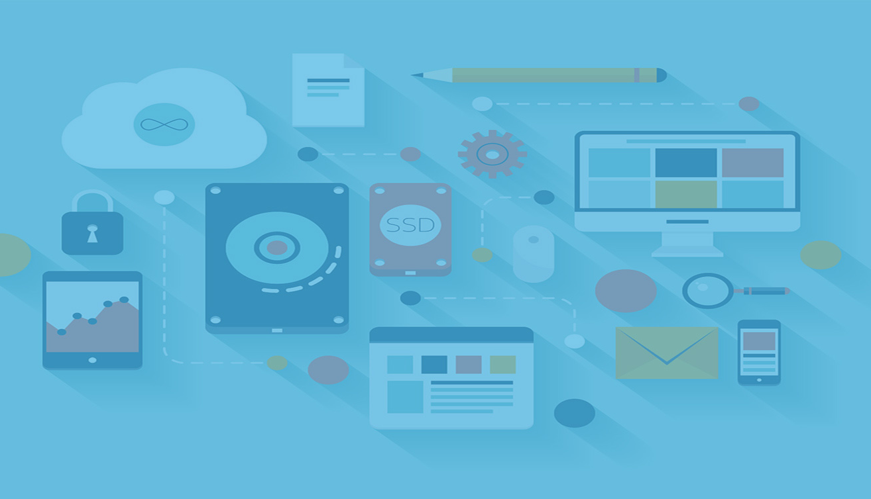

Using Raspberry Pi to Capture Environmental Factors that Affect Sleep
Hengxin Cui
Chao Guo
Tao Tang
Yixin Wu
Lei Xu

Slide 2
Team Members
Yixin Wu
Hengxin Cui
Chao Guo
Lei Xu
Tao Tang

Slide 3
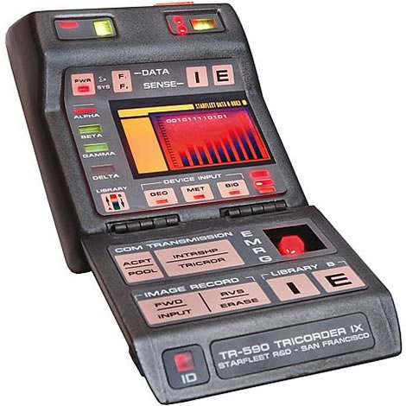
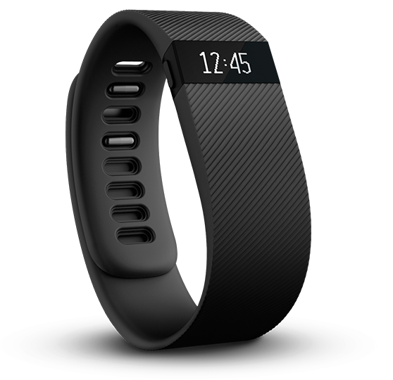
Idea
Star Trek Tricorder medical scanning
https://www.youtube.com/watch?v=1Mtk0BwcLoI
Fitbit

Slide 4
SNexus
Internet of Things application/product
Sleeping data collection and analytics
Raspberry Pi
Sensors: sound, light and motion
MongoDB
Amazon Web Services EC2
Website: http://52.26.51.149

Slide 5
Prototype
Raspberry Pi with sound and light
Raspberry Pi with motion sensor

Slide 6
Business analysis

Slide 7
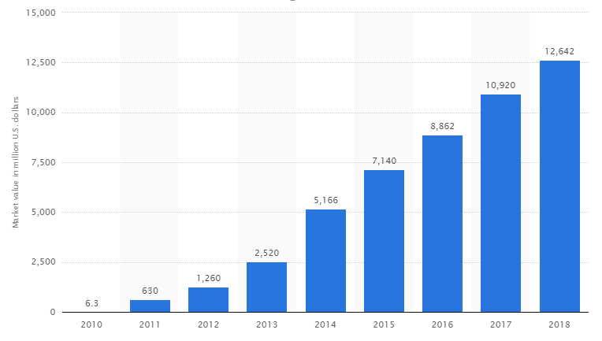
backgroung

Slide 8
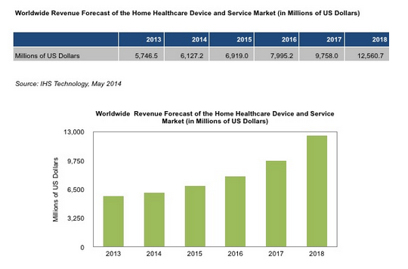
background

Slide 9
Business requirement
Good sleep is essential to everybody
People always have few knowing about their sleep quality
Sleep quality is in relation with the sleep environment
Our product can collect data related to sleep and give feed backs to user.

Slide 10
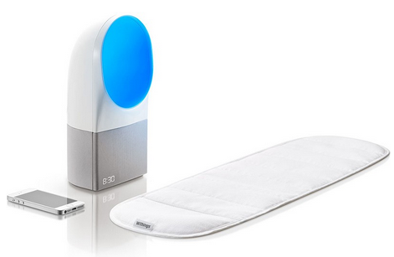
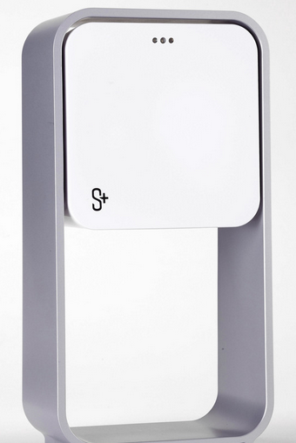
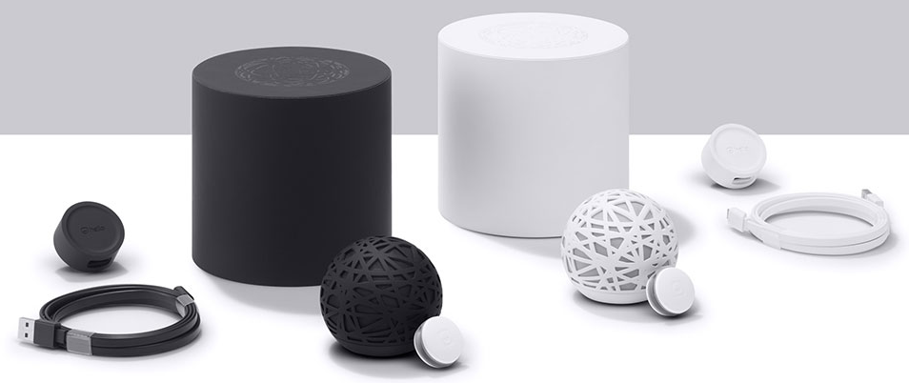
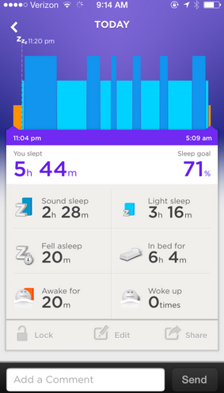
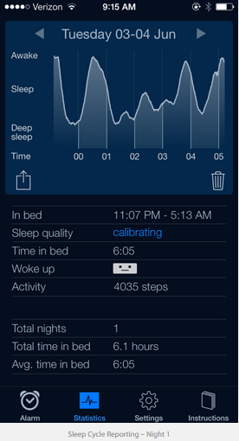
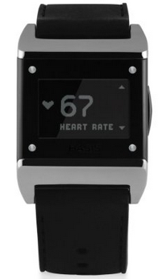
existing Products

Slide 11
What makes us unique
More valuable data service
More Reliable Comparing with Simple Devices

Slide 12
Demo demonstration

Slide 13
Web application link
http://52.26.51.149/

Slide 14
Infrastructure

Slide 15
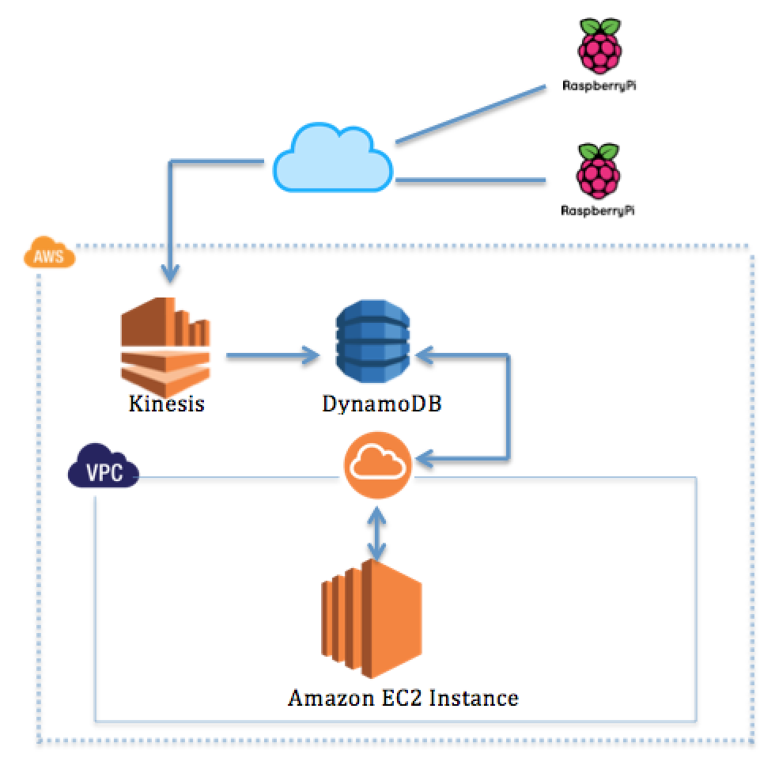
Infrastructure A—Aborted Infrastructure

Slide 16
Issue and Challenge
Expenses
Programming Challenge
Amazon Kinesis Connector Library only in Java
Budget | $500
Hardware(Raspberry Pi + Sensors) | $400
AWS(Anticipated)—Kinesis + DynamoDB + EC2---6 months | $185.04 ($30.84/month)

Slide 17
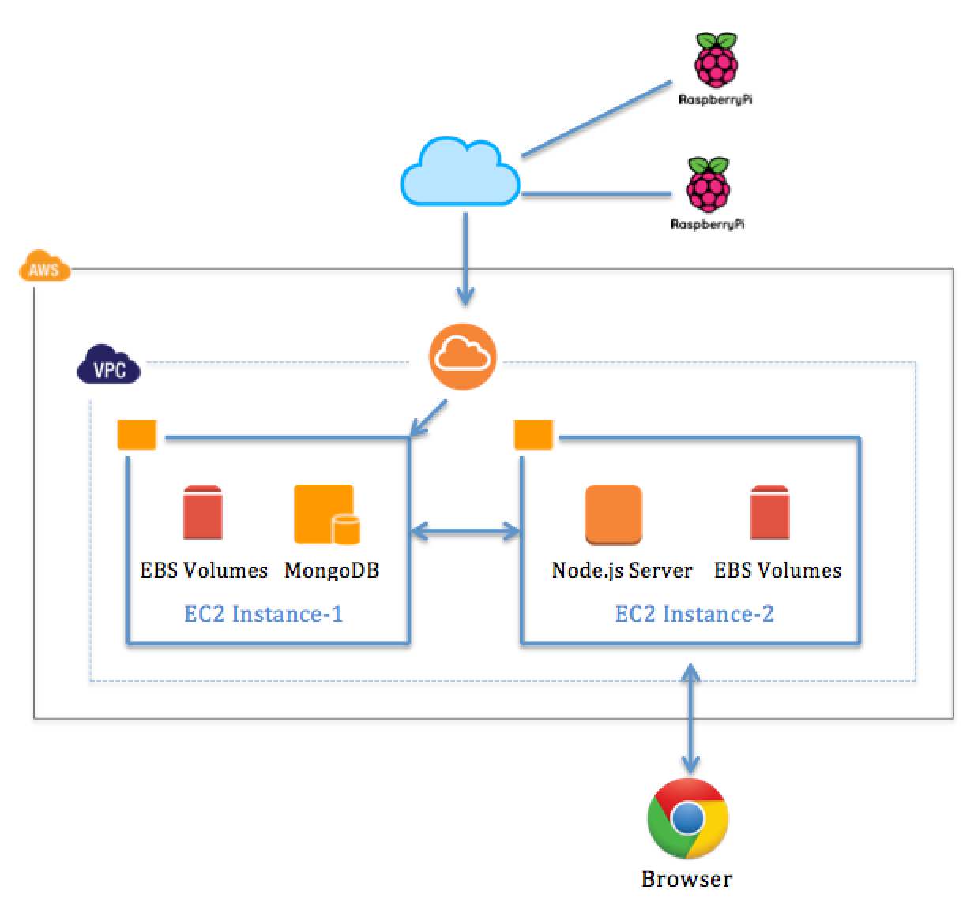
Infrastructure B

Slide 18
HARDWARE

Slide 19
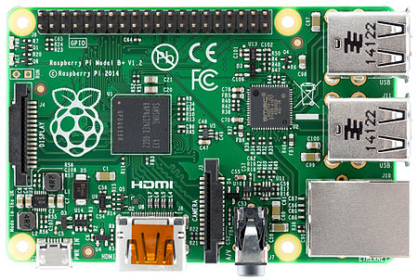
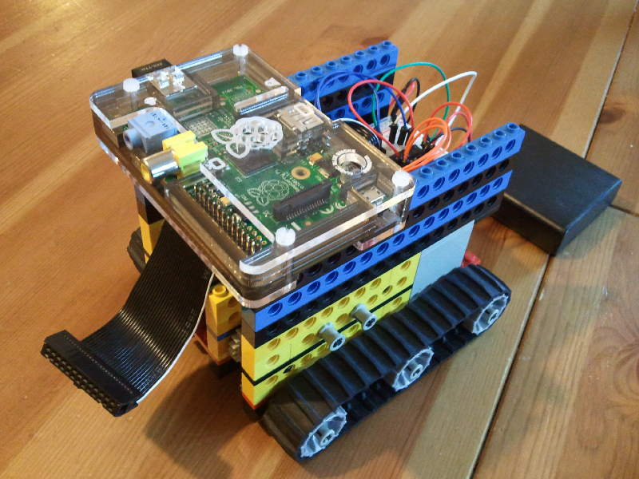
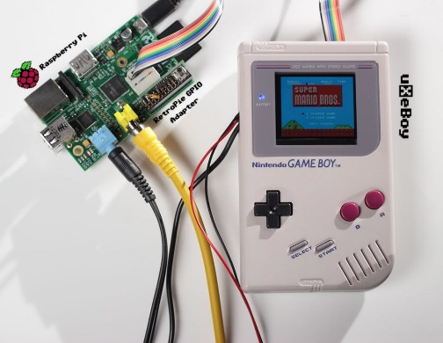
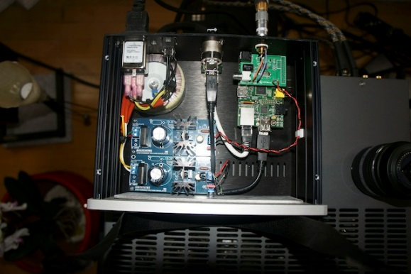
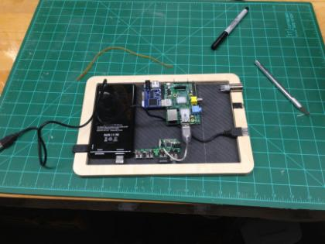
Hardware
Raspberry Pi
A series of credit card–sized single-board computers
Portable, affordable ,
Wide range of use
Robots, Gameboy, Audio player, tablet, etc.
Notes:
Hardware, it is one of the most important part since we deceived to create our own Internet of Thing project, we first need a prototype which can help us track and record the data , which is the sound volume data, light intensity data, and motion acceleration data.
And , we used Raspberry Pi to achieve it !
Raspberry Pi: Is a low cost, credit card sized computer which has built in python runtime library, so it can be programed in Python without any newly added packages. Scarcities some of the CPU and memory performance, it has the advantage of portability and affordability .
It has 4 USB and a HDMI input, which allow Raspberry Pi to connect the mouse, keyboard and monitor, and also , the most important is that Raspberry pi has multiple pins for different use, like normal IO pin, SCL, SDA pins, and so on.
Raspberry can be used widely, like making a robot, a Gameboy, even some fancy things like audio player, tablet ,etc. In our project, we connected it with sensors, to make a sleep tracker.

Slide 20
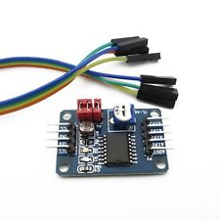
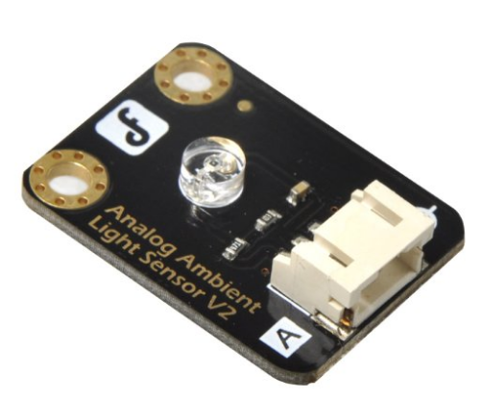
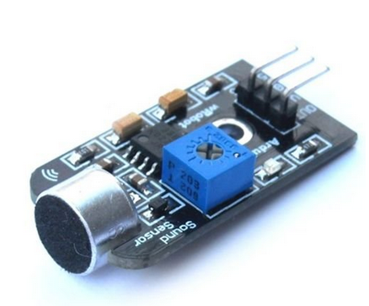
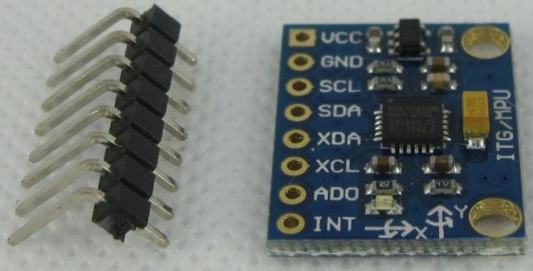
Hardware
Peripheral equipment
Mouse, Keyboard, Wi-Fi Dongle, Breadboard
Electronic component
PCF8591 AD/DA Converter Module
Analog Ambient Light Sensor
Arduino compatible Mini Sound Sensor
MPU 6050 3 Axis analog gyro sensors
Notes:
Not only the basic peripheral equipment like keyboard, mouse, we need electronic components ,the sensors. So I am going to give a quick list of the components we use in our project. PCF8591, which used for converting the analog input to digital output. Analog Ambient Light Sensor, Arduino compatible Sound Sensor and the MPU 6050 3 Axis sensors. Because the output of these sensors are analog signal, and raspberry pi only accept digital signal, so that why we need to use the PCF8591.

Slide 21
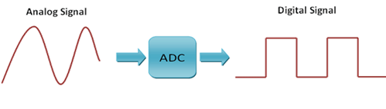
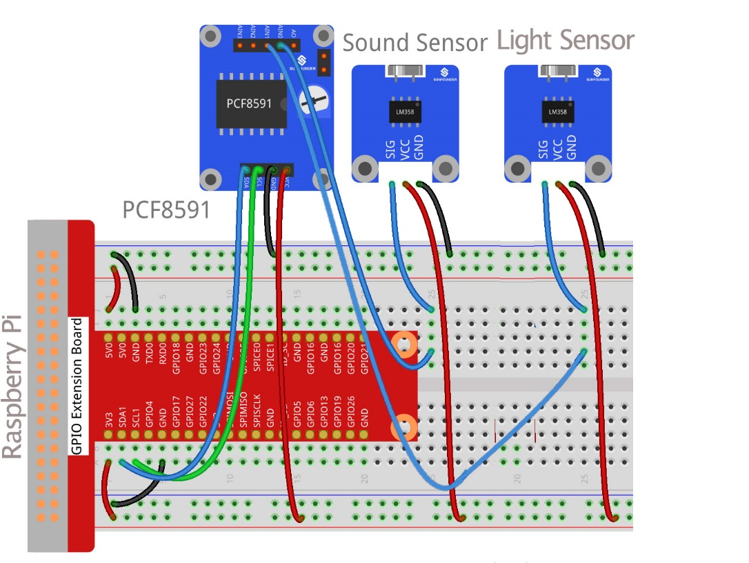
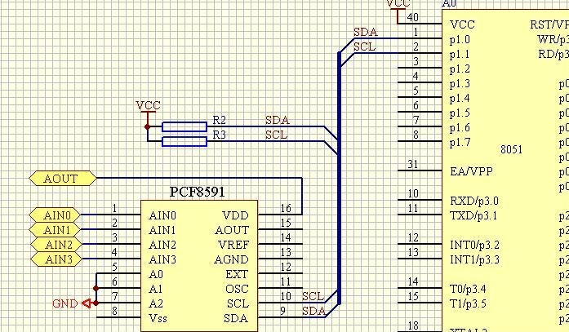
Technology
Analog to Digital
Notes:
To finish this analog to digital conversion, so we designed the circuit like the left bottom diagram, sensors connect to the pins input 0, and input 1 , and connect the SCL and SDA pins to the same pins of Raspberry Pi. These two pins are used for I2C use, which I am not going to explain here in detail. And the diagram next to it shows the connections using breadboard, which is the gray board used for easy connection.

Slide 22
Python
Libraries:
SmBUS-- Allows SMBus access through the I²C interface on Linux hosts.
Pymongo – Allows connections to MongoDB
Request – Allows making HTTP request and get response from server
PyTkinter – Allows to create an UI in python.
Notes:
We use python for scripting the sensors and raspberry Pi, the library SmBus help us do that. The Pymongo is the library we used to interact with mongoDB, and Request is used for sending request and get response from server, and the pyTkinter, is used for making the login GUI for users.

Slide 23
Difficulties , obstacles and solution
Linux operating system
Why we can not connect to Wi-Fi?
What is that error means?
Circuit design
How to make sound and light sensors more sensitive?
Python scripting
Which address are these value stored?
How to retrieve the value read from pins?
Notes:
We did face pretty much challenges in this hardware part, it’s much more hard than what we thought at the beginning, so that’s why it cost us more than a month on it .
Like the second one, because we had no experience using Linux system, many operations we would see some error showed, and we need to research how to fix the error, which , result in more errors during this fix process. These would slow down the process.
The third problem , finally we find that we need to add an amplifier to make the sensors more sensitive, the around 5 dollars sensors is not as accurate as what we think, and also , we need to design some complex circuit for amplification, and reduce the noise, and finally we decided not to go too much deep on it because of the time issue.
Also we still face difficulties in python programming, not like how to code in python , but more specific like how to retrieve data from sensors, but finally we concord them all, and came with our first milestone.

Slide 24
Platform and database

Slide 25
Platform and database
Platform: Amazon Web Services - Elastic Compute Cloud (EC2)
Database: Mongo DB
Sensor: Store all users’ sensor data, includes lightrecord, soundrecord and motionrecord. These are the original data, which collected from raspberry pi.
User: Store all the user information, such as login info and profiles
Motiondatas: Store the users’ motiondata, specifically, these data are cleaned up and well analyzed.
Sleepquality: Store the users’ sleep quality data.

Slide 26
Server side: Node.js and Express.js
Why node.js?
A JavaScript runtime built on Chrome's V8 JavaScript engine.
Node.js uses an event-driven, non-blocking I/O model that makes it lightweight and efficient.
Node.js' package ecosystem, npm, is the largest ecosystem of open source libraries in the world.
Restful api server
A uniform interface separates clients from servers.
Clients are not concerned with data storage, which improves portability.
Servers are not concerned with user interface or user state, which makes server more scalable.

Slide 27
Api structure
URL | GET | POST | PUT | DELETE
user/sensorDate | Parameters: username, sensor Response: (200) A JSON object includes a list of sensor data (204)Not found | none | none | none
user/login | Parameters: username, password Response: (200) username (401)” password is not correct” (404)” Username nor exists”
user/register | Parameters: username, password, email Response: (200) username (201) “Username exists!”

Slide 28
Api structure
URL | GET | POST | PUT | DELETE
user/resetPassword | Parameters: username, oldPassword, newPassword Response: (200)” Password has been updated (401) "Old password is not correct” | None | None | None
user/overview | Parameters: username, sensor Response: (200)A JSON object includes the date. (404)Not date
user/profile | Parameters: username Response: (200)A JSON object includes user’s profile data | Parameters: username, firstname, lastname, gender, age Response: (200) 'Profile update success'

Slide 29
Client: Backbone.js and Chart.js
User register and login
Personal profiles management
Data center overview
Data visualization and presentation
General report for user’s sleep quality

Slide 30
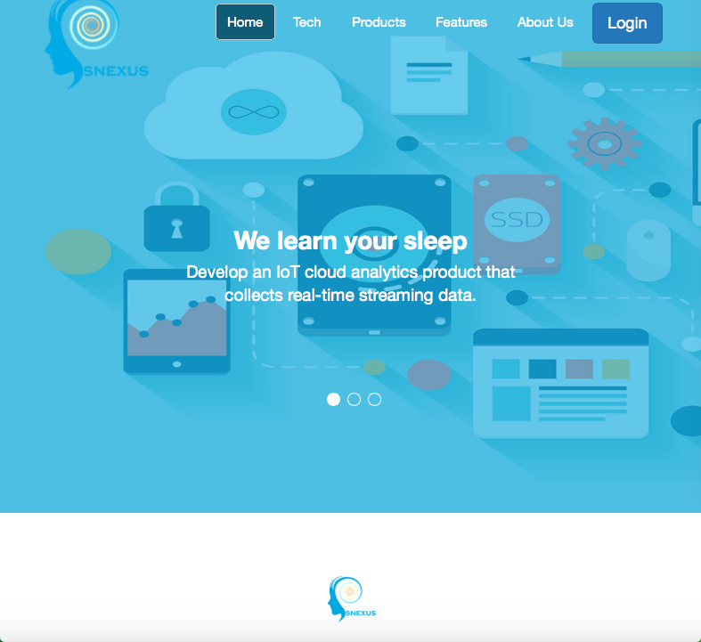
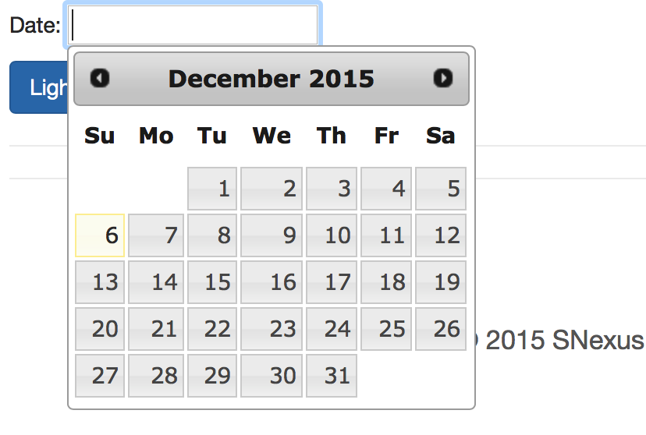
UI: Bootstrap.js, jQueryUI
jQueryUI: datapicker

Slide 31
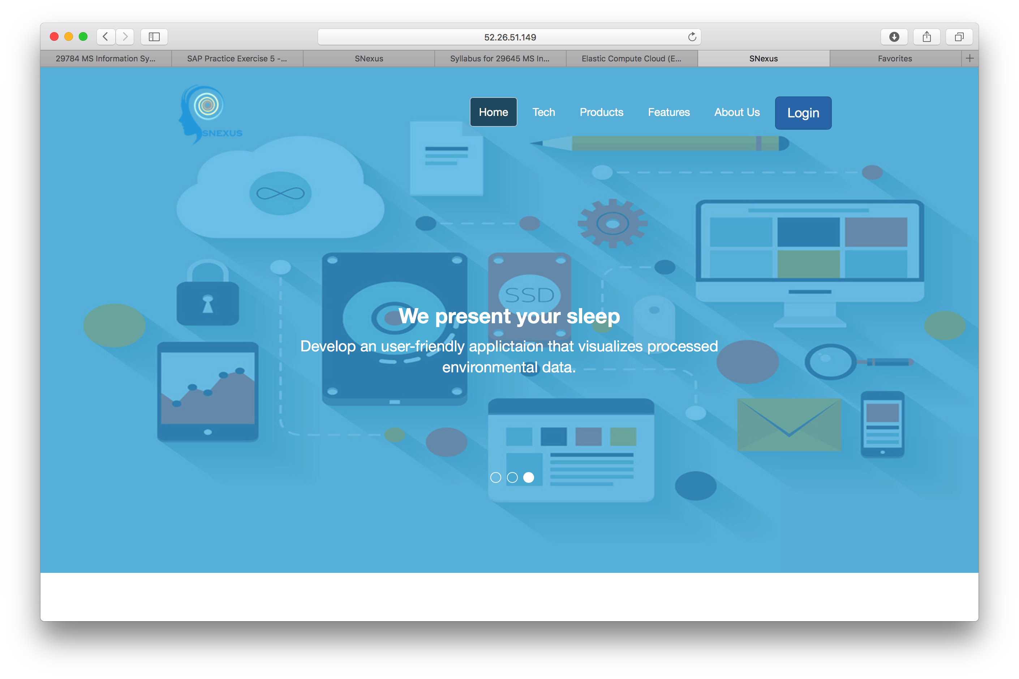
Overview structure
Sensors Data
Raspberry Pi
Mongo DB
Ec2 instance:
mongodb://52.25.49.72:27017/capstone
DB Version: MongoDB 3.0
Data
Client
Data
Server
Ec2 instance:
^{http://52.26.51.149:3000/}
Node.js(v4.2.3LTS) + Express.js = Restful Api server
Backbone.js + Chart.js
Bootstrap.js + jQueryUI

Slide 32
Sleeping Data Analysis

Slide 33
Two Questions
What’s the comparison of movements by hour during sleeping?
2. What’s the length of deep sleeping time?

Slide 34
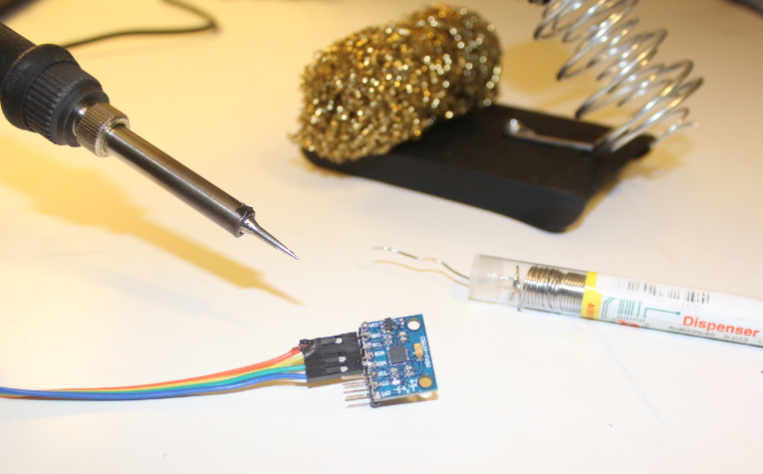
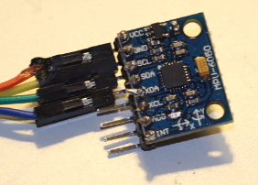
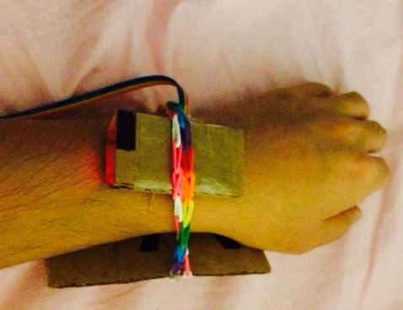
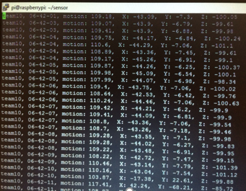
CAPTURE THE Data

Slide 35
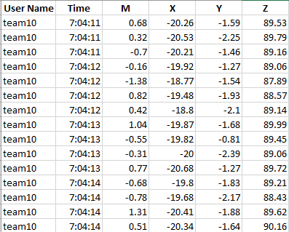
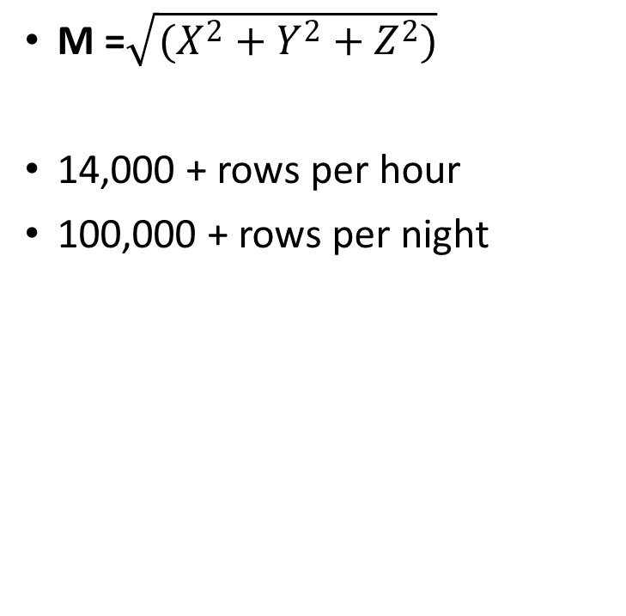
Raw Data
M =$\sqrt{(X^{2}+Y^{2}+Z^{2})}$
14,000 + rows per hour
100,000 + rows per night

Slide 36
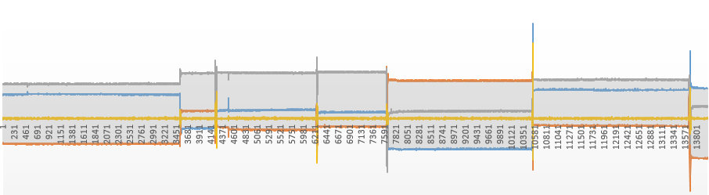
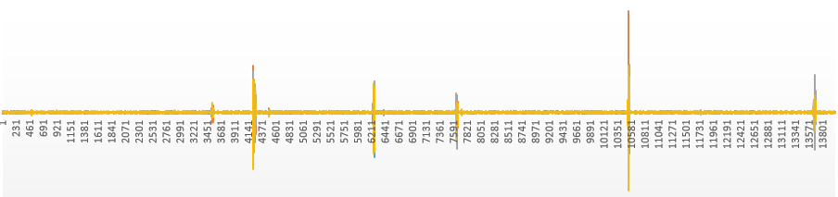
Original or Incremental?
Step

Slide 37
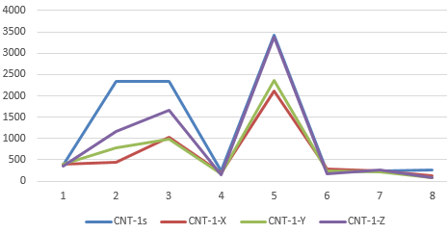
By M or By X, Y, Z ?

Slide 38
What’s the comparison of movements by hour?

Slide 39
Calculate the Counts of Movements By Hour
Calculate the average value and standard deviation of the dataset
b. Set the scope of normal movements
c. Count the number of outliers

Slide 40
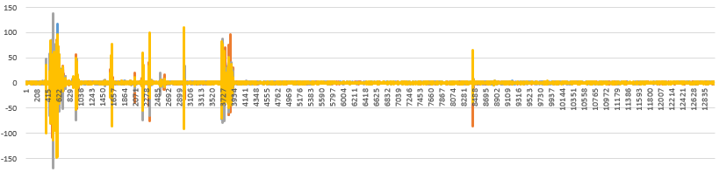
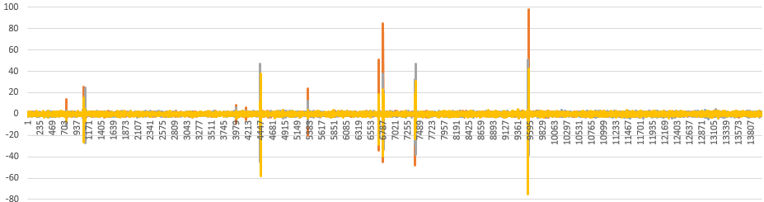
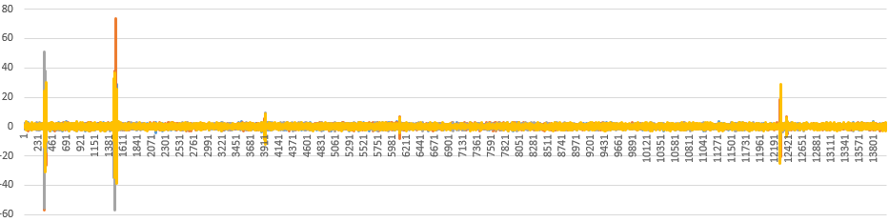
Differences by Hours

Slide 41
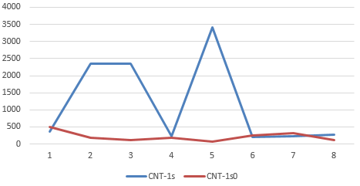
By Hour or By night?

Slide 42
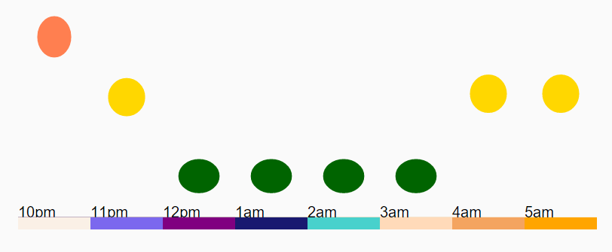
Visualize the Movements by Hour

Slide 43
What’s the length of deep sleeping time?

Slide 44
CalculatION MODEL
Classified sleep into two stages: deep sleep and light sleep
Recorded the time R when roll-overs were detected
Intervals exceeding the threshold (T4 = 20 min) were classified into deep sleep
Cited From: Miwa, H.,Sasahara, S.-i., Matsui, T.
Roll-over Detection and Sleep Quality Measurement using a Wearable Sensor.
Engineering in Medicine and Biology Society, 2007. EMBS 2007.
29th Annual International Conference of the IEEE, (pp. 1507 - 1510)

Slide 45
Calculate the Number of Movements By Hour
a. Simplify the data by each minute
b. Find out the roll-over moments and the time they happen
c. Calculate the Deep Sleep Time by looping the time intervals

Slide 46
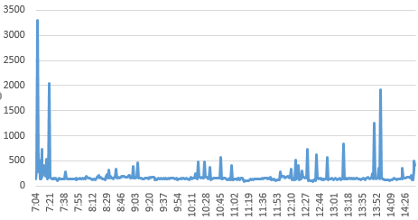
Accumulated Movements Value by Minute

Slide 47
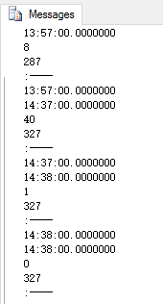
Calculate Deep Sleeping Time
Using SQL Server, loop the whole data set and finally calculate the results as:
Deep Sleeping Time: 327 Min
Deep sleep rate = 327/454 = 72%.

Slide 48
Implementation of Past knowledge
MSIS2602 Information Systems Analysis and Design
MSIS2606 Software Project Management
MSIS696 Business of Cloud Computing
MSIS696 Web Programming

Slide 49
New things we learnt
Hardware Installation
Python
Linux Shell Script
Node.JS
Backbone.JS
Business Intelligence

Slide 50
Future enhancement
Hardware
Web Application
Data Analysis

Slide 51
Thank you!

